Slide 1

Crisis Cash Management
Set up Cash Committee
Crisis Cash Management Services are not permissible for SEC audit clients and their affiliates. The full scope of Crisis Cash Management services are not permissible for IFAC audit clients and their related parties. See detailed guidance regarding Independence on slides 12-17 of the Crisis Cash Management method guide.
RESTRUCTURING
Guidance
June 2008
ADVISORY
For the purpose of this document, all references to KPMG International, a Swiss cooperative that serves as a coordinating entity for a network of independent member firms operating under the KPMG name, will be referenced as KPMG International. Throughout this document, "KPMG" ["we," "our," and "us"] refers to the local, independent KPMG member firm or firms. Throughout this document “client” [“they,” “their and “them”] refers to the local, independent member firm’s client. KPMG International provides no client services.

Slide 2
Introduction
Index
Topics Covered Slide Number
Purpose of this document Slide 2
Crisis Cash Management Overview Slide 3
Crisis cash engagements – Set up Cash Committee
Purpose of the Cash Committee Slide 4
Composition of the Cash Committee Slide 4
Objectives of the Cash Committee Slide 5
KPMG’s role Slide 6
Example Cash Committee action list Slide 7
Acronyms Slide 8

Slide 3
Purpose of this document
  This document has been prepared to assist staff in crisis cash engagements where KPMG advises clients to set up Cash Committee. It should be used as a reference tool and lays down some rules that are considered to be better practice.
  What does this document set out?
    Within this document there is guidance on how to help client management to set up and run a Cash Committee for a single entity by:
      Compose the right size and structure of the Cash Committee
      Schedule and have Cash Committee meetings
      Establish action plan and monitoring
KPMG strongly suggests to set up a Cash Committee, However, it is client’s decision to set up a Cash Committee or not. If the client chooses not to set up a cash Committee, we need to be aware of the risks this may cause as to clear communication with the client, e.g. we need to make sure we raise issues and communicate findings to the right level within the organisation.

Slide 4











Crisis Cash Engagements Overview
The typical approach during a crisis cash management engagement follows the GREG methodology and can be summarised as follows:
Initiate
Plan
Coordinate
Close
Initial assessment
This approach is illustrative and will vary depending on the size and complexity of the company
Set up Cash Committee
Tighten controls/immediate
cash initiatives
Prepare short-term receipts and payments cash flow forecast
Identify and manage key stakeholders/reporting
Monitor results/re-forecast
Identify short-term cash initiatives
Implement short-term cash initiatives
Sustainable Cash
Day
1
Day
2
Day
3
Day
4
Day
5
Week 1
Week 6
Week 8

Slide 5
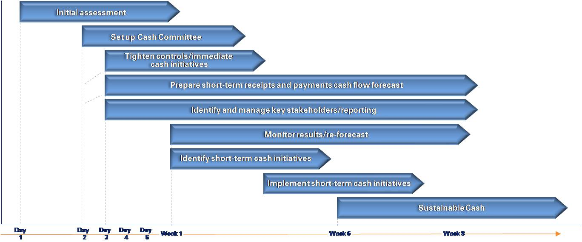

Crisis Cash Engagements Overview
Initiate
Plan
Coordinate
Close
This approach is illustrative and will vary depending on the size and complexity of the company
Set up Cash Committee
Day
1
Day
2
Day
3
Day
4
Day
5
Week 1
Week 6
Week 8
Notes
  This approach is illustrative and will vary depending on the size and complexity of the company
  KPMG’s role on these engagements can vary depending on our relationships with the client and the regulatory environment of the country in which the client is based. As such, KPMG’s role could be very 'hands-on' whereby KPMG actively drives the process in a CRO-type role. Alternatively KPMG could have the role of an advisor whereby we are advising management through each of the stages and they will have responsibility for forecasts and implementing actions.
  Similarly, the output on engagements can vary depending on client requirements. It may be required to report in detail for each stage or give brief written or verbal updates.

Slide 6
Cash committees
  Purpose of the Cash Committee
  Establishing a cash committee can be highly visible and effective measure in focusing a business on cash stabilisation/improvement.
  The Cash Committee is generally responsible for:
    Ascertaining bank facilities and the current cash position to determine available headroom
    Establishing the short-term funding requirements of the business by preparing a short-term cash flow forecast
    Implementing new short-term cash management controls, where necessary
    Developing and implementing short-term/longer-term cash generation and preservation initiatives and action plans
    Managing messages to internal and external stakeholders
  Composition of the Cash Committee
  The size and structure of the company will determine the composition of the Cash Committee. The Cash Committee should be cross-functional with a mix of finance, sales, purchasing and operational people involved. The finance department will have a key role in cash management and will have a significant representation on the team. Finance people involved will typically include, but will not be limited to:
    The finance director
    The treasurer
    Senior people within the accounts receivable and payable departments
  Non-finance representatives on the Cash Committee may include the senior people responsible for sales, purchasing, production and stock management

Slide 7
Cash committees
  Objectives of the Cash Committee
  It is important that the Cash Committee is empowered to make decisions affecting all areas of the business
  By containing representatives from finance and other areas of the business, the Cash Committee will be able to better assess the ramifications of actions proposed in advance of them being taken
  These meetings should serve to heighten awareness among senior management of the cash issues facing the business and the need to focus on the cash impact of future decisions on the business
  Effective co-ordination within the team is essential for successful delivery. Initially, daily meetings should be held to discuss stabilisation issues and to identify cash preservation and generation initiatives. The production of an agreed action plan during each meeting will help ensure that the team remains focused and each member of the team understands his/ her role and responsibilities.
  Once the Cash Committee members feel that they are managing the cash stabilisation process effectively, the frequency of cash meetings may be reduced to two times a week and later to once a week or less as they feel necessary.

Slide 8
Cash committees
  KPMG’s role
  To help identify the potential members of the Cash Committee.
  KPMG plays a key role to:
    Initially facilitate the meetings
    Drive progress and maintain momentum
    Challenge existing working practices
    Challenge decisions being made by the Cash Committee
    Help establish and maintain action plans and tracking tools
  KPMG’s role is not to:
    Lead Cash Committee meetings
    Change working practices and controls
    Make decisions
    Communicate decisions to internal and external stakeholders
    Implementing decisions

Slide 9
Example Cash Committee action list
Req | Action | Who | When | Status | Notes
20-Jan | Distribute the latest weekly update reports | Mr. AAA | 20-Jan | ■
20-Jan | Develop working capital improvement proposals | Central Cash Team (‘CCT’) | 26-Jan | ■
20-Jan | Contact accounting controlling team | Mr. VVV | a.s.a.p. | ■
25-Jan | KPMG to comment on first cash flow forecast/ second forecast instructions. | KPMG | 31-Jan | ■ | Forecast received on 25 Jan, comments to be fed back on 31 Jan /earlier
20-Jan | Working capital improvement workshops to be developed | Mr. XXX/ Mr. YYY | 02-Feb | ■
20-Jan | KPMG to provide examples of leading practice workshops | KPMG | 02-Feb | ■
20-Jan | Analyze/ evaluate cash management tools | Mr. ZZZ | 15-Feb | ■
25-Jan | Communication with Entity Cash Leaders to be developed | Mr. WWW | 31-Jan | ■

Slide 10
Acronyms
ABL | Asset Based Lenders
ADD | Average Days Delinquent
AP (A/P) | Accounts Payable
AR (A/R) | Accounts Receivable
BACS | Bank Automated Clearing System
BPDPO | Best Possible Days Payable Outstanding
BPSO | Best Possible Days Sales Outstanding
CAPEX | CAPital EXpenditure
CIS | Contracts Information System
COD | Cash On Delivery
CRA | Credit Rating Agency
CRO | Chief Risk Officer
DAO | Days Accrued Outstanding
DB | Defined Benefit
DC | Defined Contribution
DD | Direct Debit
DIA | Days of Inventory Available
DIH | Days Inventory Held
DIO | Days of Inventory Outstanding
DPO | Days Payable Outstanding
DSO | Days Sales Outstanding
DUO | Days Unbilled Outstanding
EBITDA | Earnings Before Interest, Tax, Depreciation and Amortization
EDI | Electronic Data Interchange
FX | Foreign Exchange
GRNI | Goods Received Not Invoiced
G/L | General Ledger
HMRC | Her Majesty's Revenue and Customs (UK)
LIBOR | London Interbank Offered Rate
NIC | National Insurance Contributions
NPD | New Product Development
PAYE | Pay As You Earn
PE | Private Equity
PPF | Pension Protection Fund
R&D | Research and Development
ROCE | Return On Capital Employed
ROI | Return On Invested Capital
SKU | Stock Keeping Unit
SO | Standing Order
SoC | Schedule of Contributions
STCF | Short Term Cash Flow forecast
VAT | Value Added Tax
VMI | Vendor Managed Inventory
WIP | Work in Progress

